Slide 1
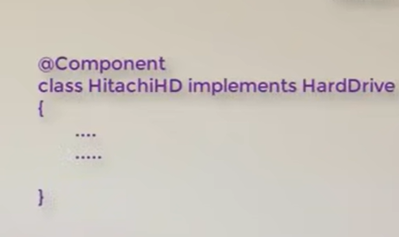
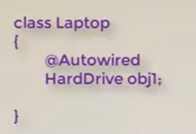
Spring
The above two classes get connected

Slide 2
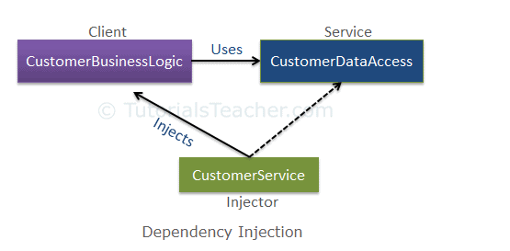
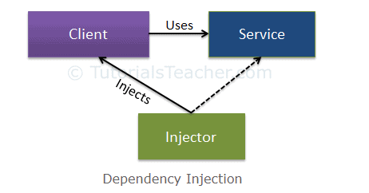
Dependency Injection :
1).What Is DI?
Answer : Dependency Injection is a programming technique that makes a class independent of its dependencies. It is a technique where one object supplies the dependencies of another object.
2).Why we need?
Answer : We need DI because we need to achieve loose coupling we don’t want tight coupling. Ex:Laptop Hard Drive

Slide 3
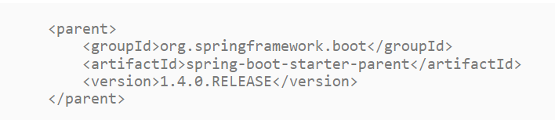
Spring Boot Starter Parent
1).What is spring boot starter parent?
Answer : All Spring Boot projects typically use spring-boot-starter-parent as the parent in pom.xml.
Parent Poms allow you to manage the following things for multiple child projects and modules:
Configuration - Java Version and Other Properties
Dependency Management - Version of dependencies
Default Plugin Configuration

Slide 4
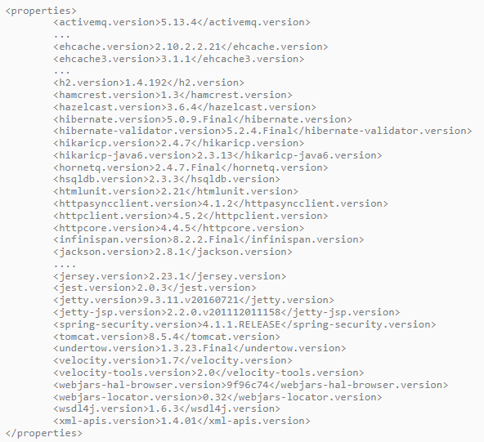
Dependency Management

Slide 5
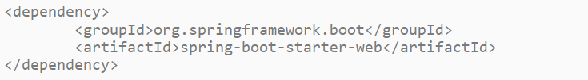
Spring Starter Projects
What if we do not have starter projects?
Answer : Let’s say we want to develop a web application with Spring MVC.
First of all we would need to identify the frameworks we want to use, which versions of frameworks to use and how to connect them together.
Listed below are some of the dependencies we use in our Spring MVC Course. These include Spring MVC, Jackson Databind (for data binding), Hibernate-Validator (for server side validation using Java Validation API) and Log4j (for logging). When creating this course, we had to choose the compatible versions of all these frameworks.
Spring Boot Starter Web :
Spring Boot Starter Web brings in 2 important features
Compatible Dependencies that are needed to develop web applications
Auto Configuration
Dependency for Spring Boot Starter Web

Slide 6
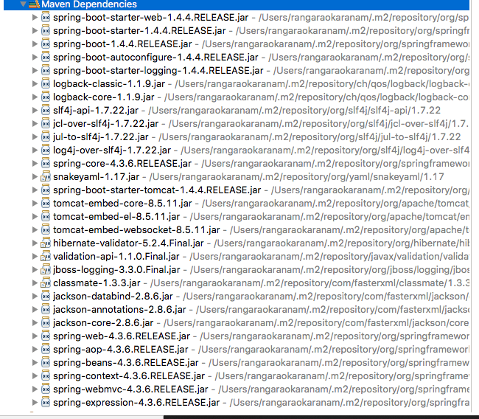
Dependencies
Following screenshot shows the different dependencies that are added in to our application

Slide 7
Spring Boot Starter Project Options :
As we see from Spring Boot Starter Web, starter projects help us in quickly getting started with developing specific types of applications.
spring-boot-starter-web-services - SOAP Web Services
spring-boot-starter-web - Web & RESTful applications
spring-boot-starter-test - Unit testing and Integration Testing
spring-boot-starter-jdbc - Traditional JDBC
spring-boot-starter-hateoas - Add HATEOAS features to your services
spring-boot-starter-security - Authentication and Authorization using Spring Security
spring-boot-starter-data-jpa - Spring Data JPA with Hibernate
spring-boot-starter-cache - Enabling Spring Framework’s caching support
spring-boot-starter-data-rest - Expose Simple REST Services using Spring Data REST
There are a few starters for technical stuff as well
spring-boot-starter-actuator - To use advanced features like monitoring & tracing to your application out of the box
spring-boot-starter-undertow, spring-boot-starter-jetty, spring-boot-starter-tomcat - To pick your specific choice of Embedded Servlet Container
spring-boot-starter-logging - For Logging using logback
spring-boot-starter-log4j2 - Logging using Log4j2

Slide 8
Actuator : Production ready features to help you monitor and mange your application

Slide 9

Dev Tools :
DevTools stands for Developer Tool. The aim of the module is to try and improve the development time while working with the spring Boot application. Spring Boot DevTools pick up the changes and restart the application.
Property Defaults
Automatic Restart
Live Reload
Remote Applications

Slide 10
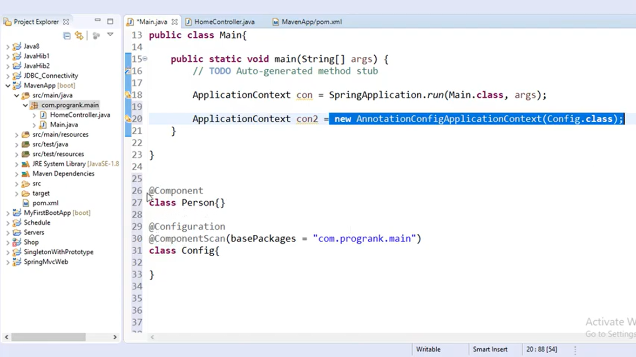

Slide 11
Dispatcher Servlet
The Dispatcher Servlet is the front controller in Spring web applications. It's used to create web applications and REST services in Spring MVC. In a traditional Spring web application, this servlet is defined in the web.
It is initialized when we hit the server.
It is not initialized when tomcat is started.

Slide 12
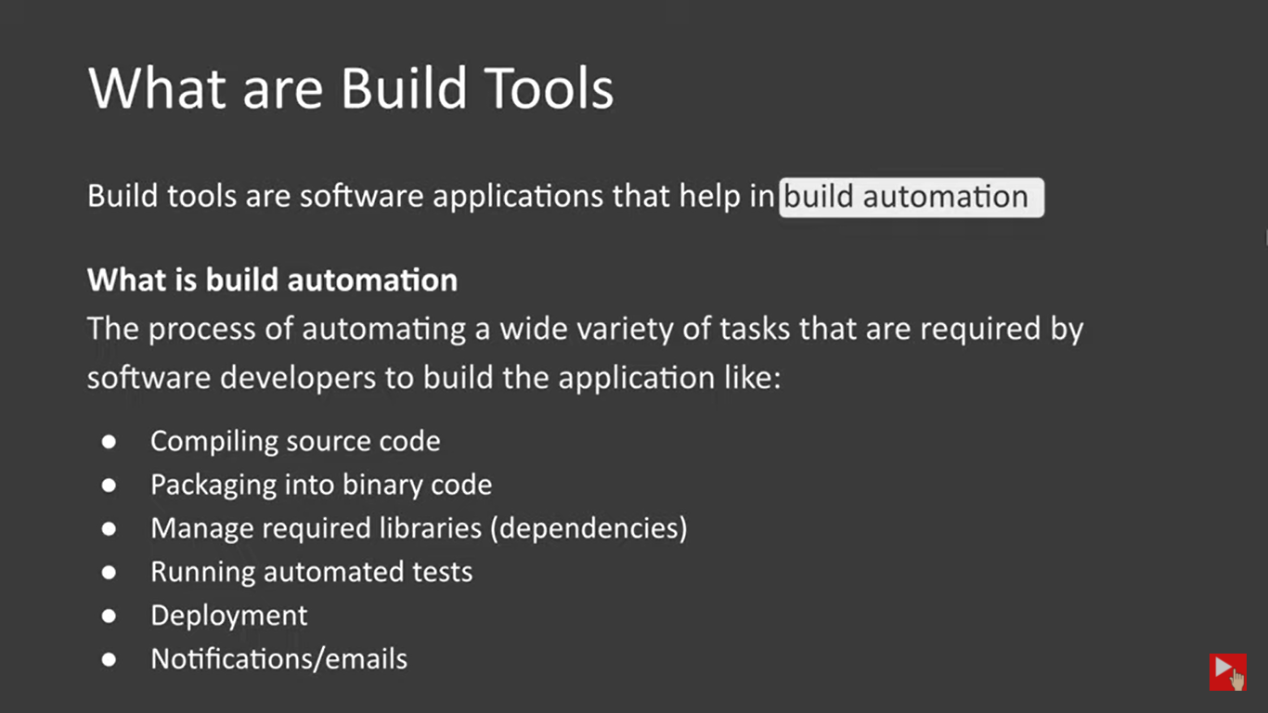

Slide 13
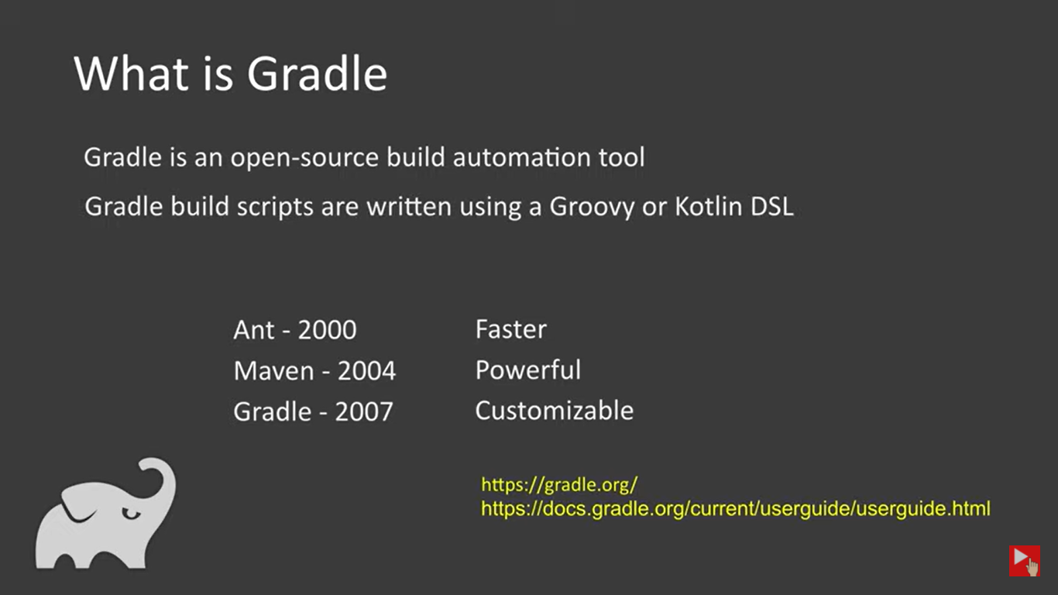
Some common build tools
Apache Ant
Apache Maven
Gradle
Grunt
Gulp

Slide 14
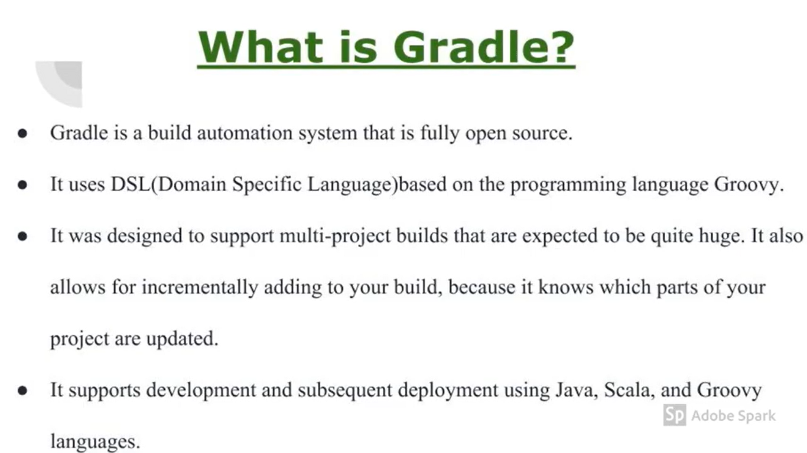
Gradle

Slide 15
Gradle
Gradle is an open-source build automation tool focused on flexibility and performance. Gradle build scripts are written using a Groovy or Kotlin DSL.
Highly customizable — Gradle is modeled in a way that is customizable and extensible in the most fundamental ways.
Fast — Gradle completes tasks quickly by reusing outputs from previous executions, processing only inputs that changed, and executing tasks in parallel.
Powerful — Gradle is the official build tool for Android, and comes with support for many popular languages and technologies.
Gradle: Gradle is an open-source tool that helps us to create software with mechanization. This tool is widely used for the creation of different kinds of software due to its high performance. It works on Java and a Groovy-based Domain-Specific Language (DSL) for developing the project structure. Gradle supports the creation of mobile and web applications with testing and deploying on various platforms. With its functionality, it is preferred as an official tool for developing Android applications.
Maven: Maven is an open-source project management tool that helps us to create different software in the lifecycle used by this tool. This tool focuses on the standardization (i.e.) development of the software in a standard layout within a short duration of time. With this, we can create Java projects but is compatible to be used for other languages too. Maven uses Extensible Markup language(XML) for the structuring of the application.

Slide 16
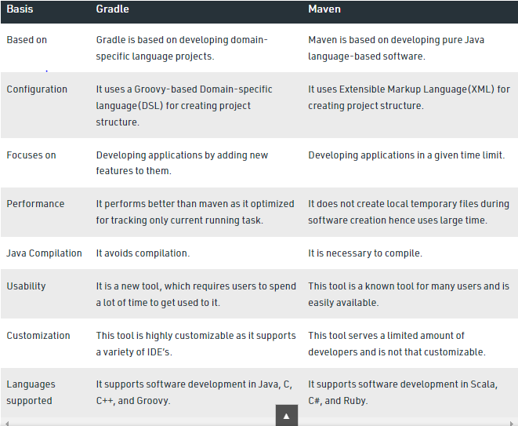
Difference between Gradle and Maven

Slide 19
Dialect
The dialect specifies the type of database used in hibernate so that hibernate generate appropriate type of SQL statements. For connecting any hibernate application with the database, it is required to provide the configuration of SQL dialect.

